Slide 1


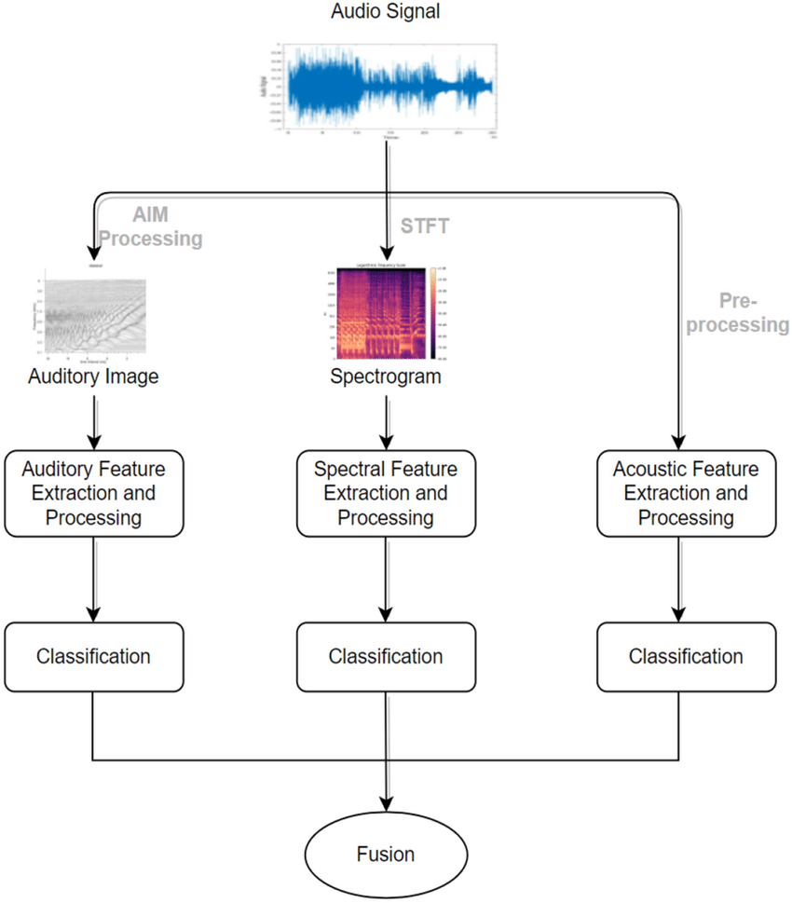
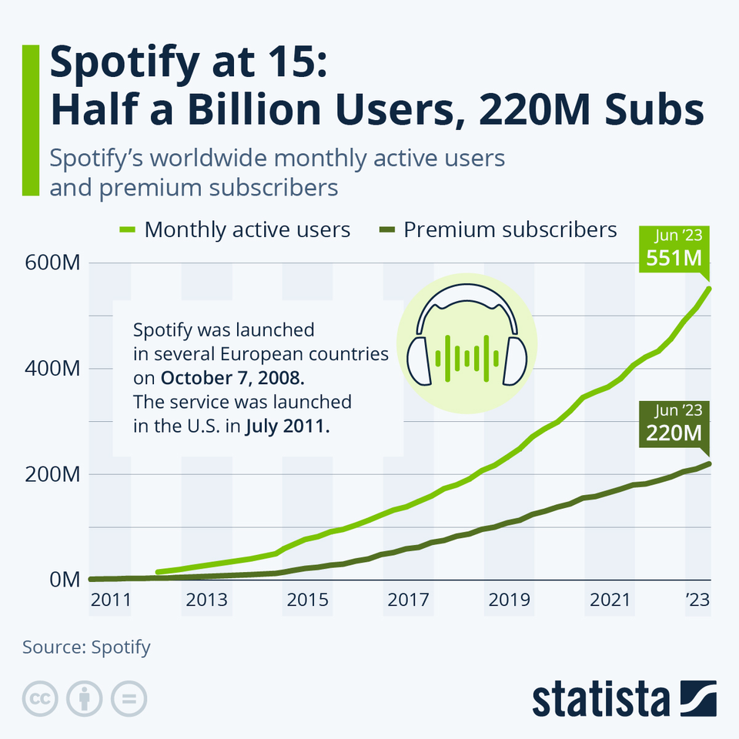
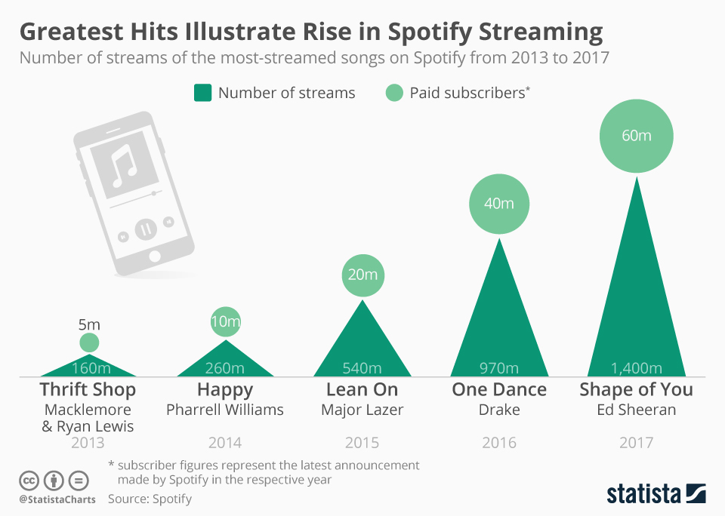
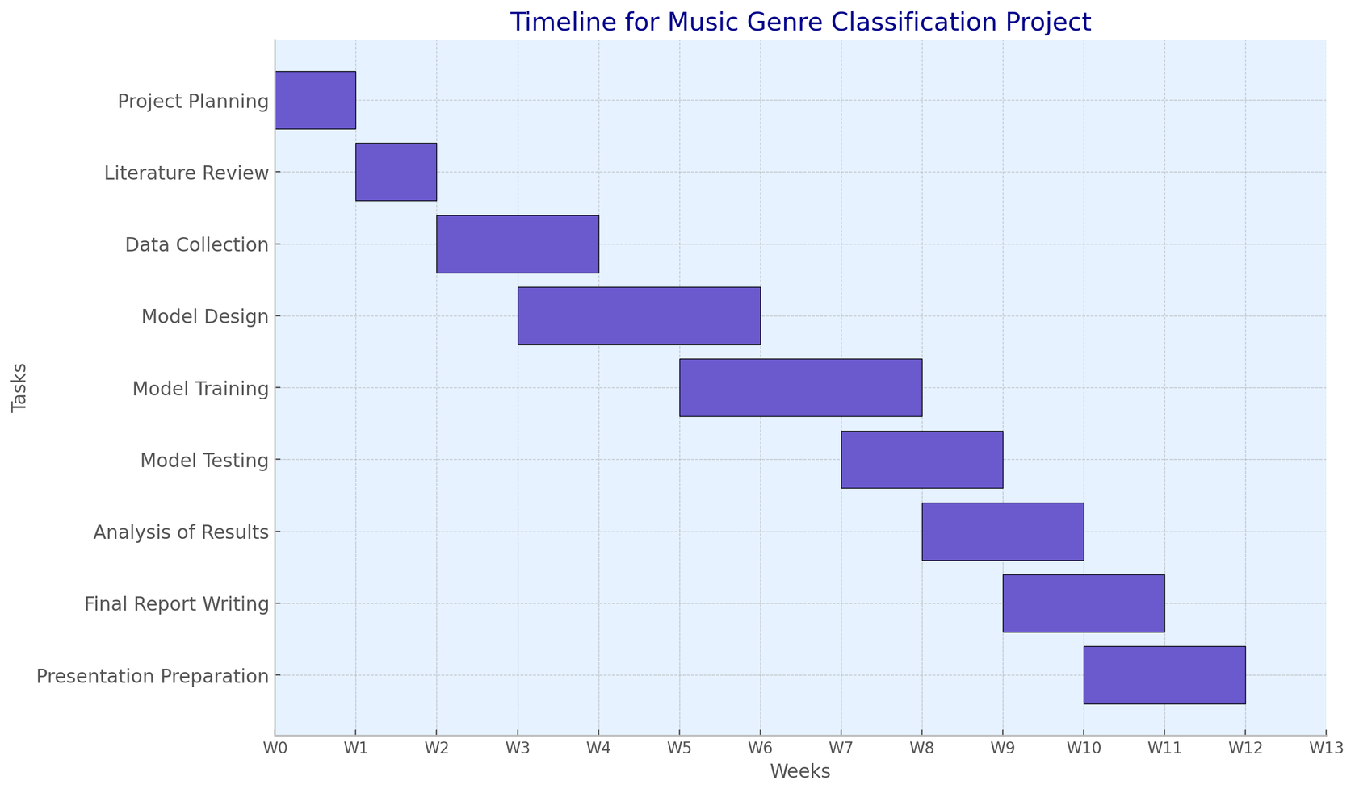

Music Genre Classification using Deep Learning
Evaluation Methodology
  Dataset: Million Song Dataset, GTZAN, custom datasets from music streaming services
  Models: Convolutional Neural Networks, Recurrent Neural Networks (LSTMs), hybrid architectures
  Data Representations: Raw waveforms, Spectrograms, Mel-spectrograms
  Transfer learning from pre-trained models on large audio datasets
  Data Augmentation techniques like time stretching, pitch shifting
Purpose
  Develop deep learning models for accurate automatic classification of music genres
  Explore effective neural network architectures and training strategies for this task
  Investigate data representations and preprocessing techniques for music audio signals
  Anticipated product: High-performance music genre classifier with potential industry applications
Background & Context
  Music genre classification is a challenging problem in music information retrieval (Sturm 2014)
  Traditional approaches using hand-crafted audio features face limitations (Gouyon et al. 2008)
  Deep learning has shown promising results on various audio tasks like speech recognition (Hinton et al. 2012)
  Potential for deep models to learn discriminative representations directly from raw audio data (Choi et al. 2017)
Research Methodology
  Dataset: Million Song Dataset, GTZAN, custom datasets from music streaming services
  Models: Convolutional Neural Networks, Recurrent Neural Networks (LSTMs), hybrid architectures
  Data Representations: Raw waveforms, Spectrograms, Mel-spectrograms
  Transfer learning from pre-trained models on large audio datasets
  Data Augmentation techniques like time stretching, pitch shifting
Ethical Considerations
  Usage of properly licensed music datasets
  Accounting for cultural/geographical biases in datasets
  Fairness in genre representations - avoiding bias towards mainstream genres
  Privacy implications if using user data from music services
Reference List
Sturm, B. L. (2014). A survey of evaluation in music genre recognition. In International Workshop on Adaptive Multimedia Retrieval (pp. 29-66). Springer, Cham.
Gouyon, F., Dixon, S., Pampalk, E., & Widmer, G. (2008). Evaluating rhythmic descriptors for musical genre classification. In AES Convention 114. Audio Engineering Society.
Hinton, G., Deng, L., Yu, D., Dahl, G. E., Mohamed, A. R., Jaitly, N., ... & Kingsbury, B. (2012). Deep neural networks for acoustic modeling in speech recognition. IEEE Signal Processing Magazine, 29(6), 82-97.
Choi, K., Fazekas, G., & Sandler, M. (2017). Automatic tagging using deep convolutional neural networks. In Proceedings of the 18th International Society for Music Information Retrieval Conference (ISMIR 2017) (pp. 805-811).

